Slide 1
Project Report
Rylee Cutter

Slide 2
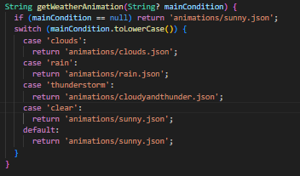
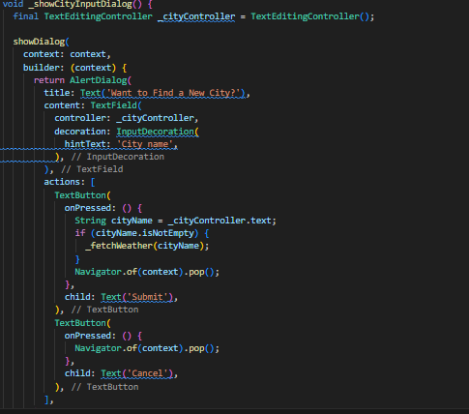
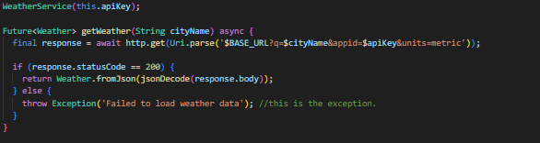
Implementations
I used animations for the first time while developing this project. Which became crucial to the end result.
I also implemented geolocation to find the user’s city and the weather around.

Slide 3
Failures/Struggles
This project took a ton of willpower. The implementation of the geolocator and geocoding packages was extremely difficult at first. Especially because in the pub.dev files, there is not a direct mention to the permission_handler package, which I ended having to use.
Besides programming the actual logic in Dart, I also had to go into the .xml android files to gain access to location permissions. That wasn’t as difficult as the logic, but it did make me have to learn a new skill while doing this project.
Lastly, the implementation of the .json animations was also new, so the logic of displaying each animation with the correct weather was difficult.

Slide 4
Goal:
My initial goal was to make a multi-page app which was similar to the standard Apple Weather app. However, during the creation of my app, I realized that the time commitment would have been much greater than I could afford. Furthermore, some of the features were extremely confusing and I had already needed to solidify my basic skills.
The app was not a failure. I did achieve features like Geolocation and animation which I did not know how to do before embarking on this development.

Slide 5
Key Features:
Looking at other cities’ weather.
Automatic Geolocation
Light/Dark Mode
Animations

